Slide 1
Securing a Spring Web Application
Soham Sengupta

Slide 2
What we shall do -
Create a simple MVC Application using Spring BOOT
Structure JSP pages in different folders
Impose Spring Security to restrict access to the pages
Impose conditional restriction
Configure Login and Logout and actions
Configure source of User Details

Slide 3
Create an MVC Application-1
You may use Spring BOOT Initializer https://start.spring.io/
Import the template application as an existing MAVEN project into Eclipse workspace
Build with MAVEN –
Hang on, - some of the dependencies might take a while to download to your Local MAVEN repository if they’re not there already.

Slide 4
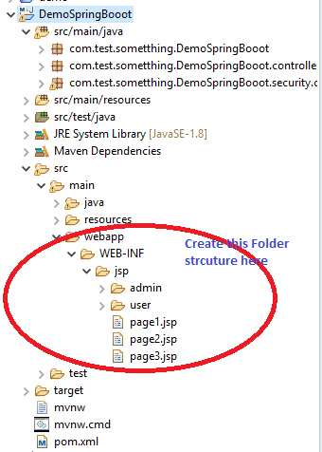
Create an MVC Application-2
Expand the project in PROJECT-EXPLORER
Create the FOLDER hierarchy as shown , under
src→ main→ webapp→ WEB-INF→jsp
Also create two folders, admin and user under jsp
Finally , we code
Dependencies are declared here

Slide 5




Create an MVC Application-3

Slide 6

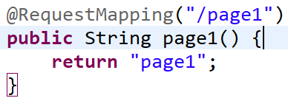
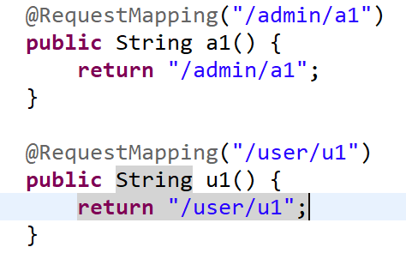
Create an MVC Application-4
Create a @Controller
Create methods with @RequestMapping

Slide 7
Create an MVC Application-5
Just to remind you, if you have forgotten-
GET Request (E.g. via Browser) to /page1 takes you to /WEB-INF/jsp/page1.jsp
/admin/a1 is resolved to the View provided by /WEB-INF/jsp/admin/a1.jsp
All these pages are OPEN
We need to protect these pages

Slide 8

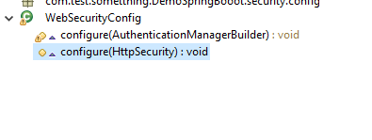
Securing a Spring MVC Application
Create a subclass of WebSecurityConfigurerAdapter
Annotate the class-
Override the two methods
Let’s discuss a while later
This for HttpSecurity

Slide 9
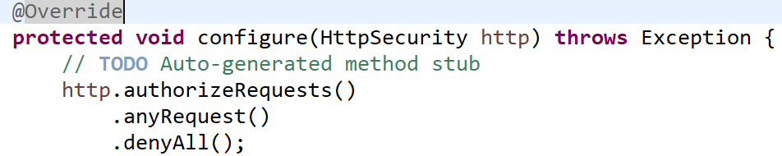
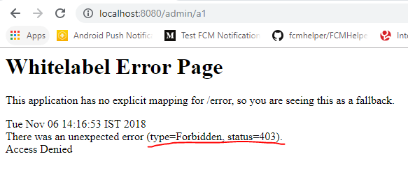
Restrict all pages

Slide 10
Changed Requirement
Keep all pages OPEN except those under /WEB-INF/jsp/admin
Such pages must be accessed after a Login activity for security
Solution:
We have all these pages mapped in the @Controller to patterns /admin/a1, /admin/a2 etc.
We can assign generic request pattern - /admin/**

Slide 11
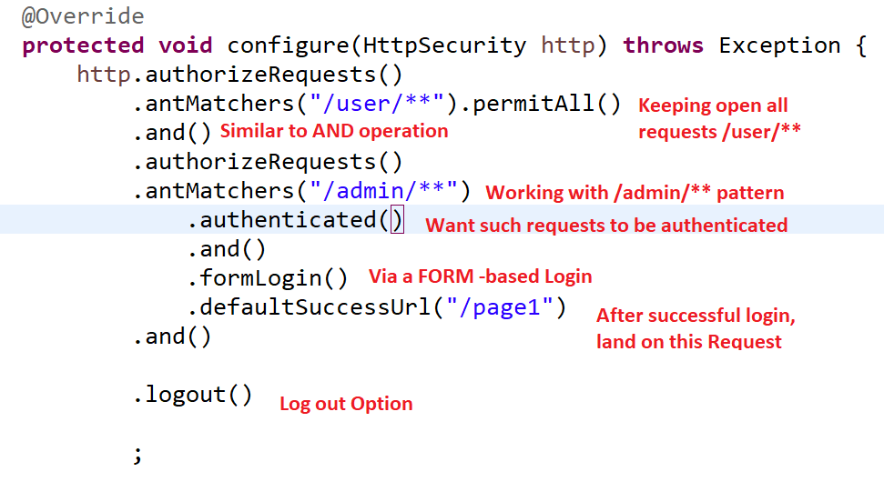
Code snippet

Slide 12
We can do many things more
I Recommend that you start exploring these –
Custom handling of FORM-based login activity
Customize the Log-out event and URL
Can you implement a small “Remember-Me “ functionality ?

Slide 13

To –Study
ANT matcher
Precedence Rules for applying antMatchers

Slide 14
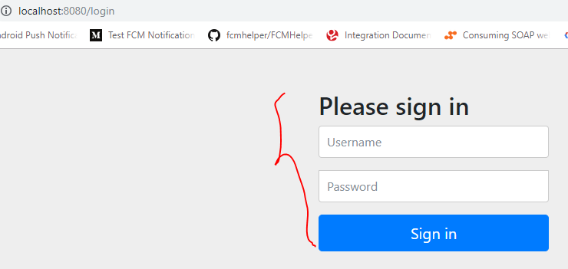
Anyway, what are my credentials?
After running the application, if we attempt to access /admin/a1, we get a Login FORM – that we did not create!
BUT, what are my credentials ?

Slide 15
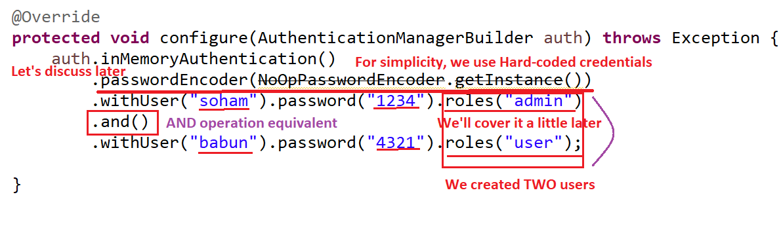
Configure your Users

Slide 16

Configure your Users –Use Database

Slide 17
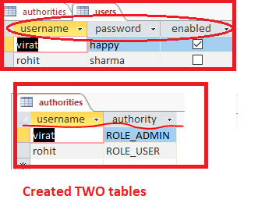
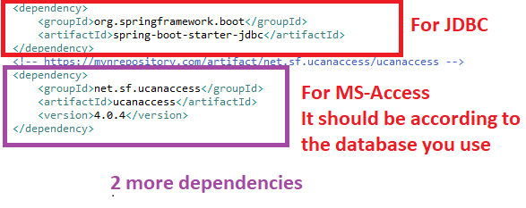
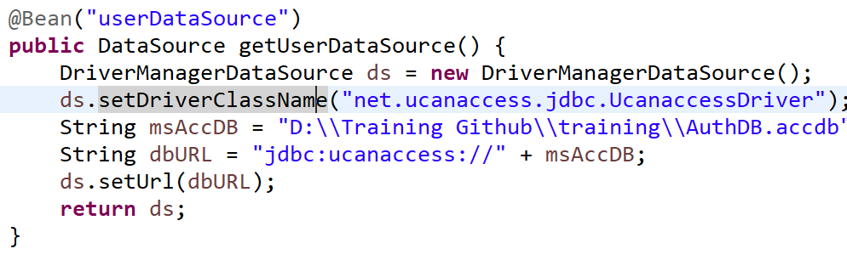

Create two tables

Slide 18
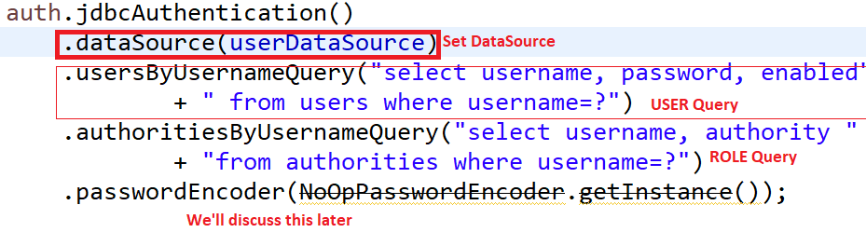

Slide 19
Next Topics-
Authentication Vs. Authorization
ROLE based access
Enforce HTTPS
Custom User Tables
PasswordEncoder –what and why?
Securing Views based on ROLE of user
Intercepting requests and filters

